Slide 1
Hospital Management System: The Ultimate
The Ultimate Guide to Streamlining Healthcare.
Guided by: Vardharajan A.

Slide 2
Group members :
Gajanan Bhokare (Team Leader) [ EBEON1222719298 ]
Vaishnavi Shinde [EBON1222703330]
Sourabh Patil [EBEON1222720600]
Adnan Maner [EBEON1222700932]

Slide 3
Introduction
The Hospital Management System is a comprehensive software solution designed to streamline the administrative and clinical workflows of healthcare facilities.
This system includes various modules such as patient management, appointment scheduling, pharmacy inventary, and more, all of which work together to improve the overall efficiency and quality of care provided by hospitals.

Slide 4
Hospital management system: modules
Admin module
User module (patient)
Doctor module
Appointment scheduling module

Slide 5
Hospital management system:
Goal of your modules:
User friendly
Simple fast
Low cost and effective
It deals with the collection of patient’s information

Slide 6
Admin module:
Register –Sign in (log in)
manage departments of hospital user, doctor accounts.
watch appointment of users(patients)
watch medicine status of hospital stock
Admin has right to change the information of doctors like name, qualification and password.

Slide 7
Doctor module:
Create, manage appointment with patient
Create prescription for patient
Provide medication for patients
Issue for operation of patients and creates operation updates
Manage own profile

Slide 8
User module (patient):
Registration
Log in
View appointment list and status with doctors
View prescription details
View medication from doctor
View doctor list
View history

Slide 9
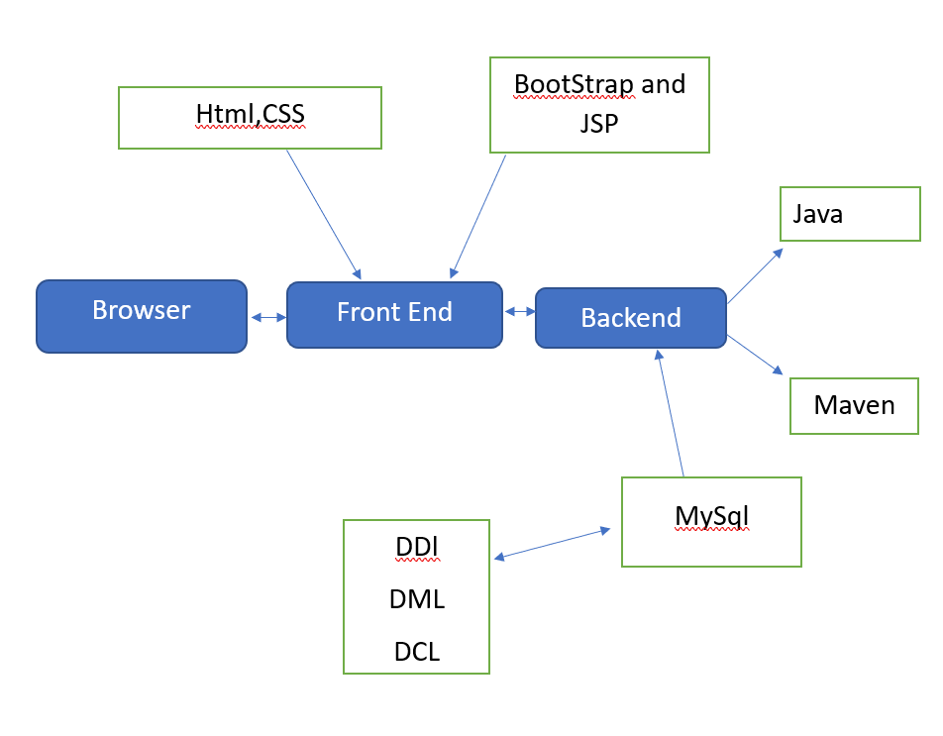
Tech architecture:

Slide 10
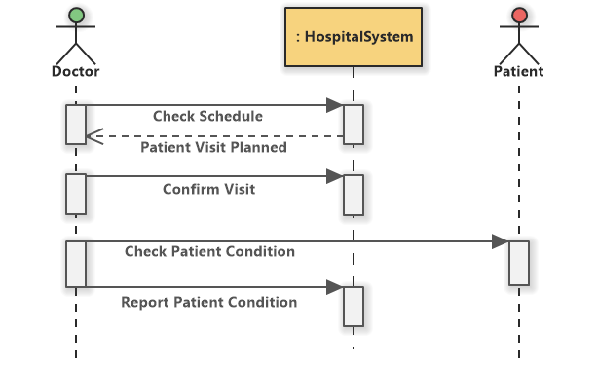
Dataflow diagram:

Slide 11
Challenging issues
Database connectivity issue
Some coding issues

Slide 12
Testing:
Testing module | Expected results | Pass/fail
Admin
1)Admin Log in. | Admin will login into system successfully. | Pass
2)Add doctor | Admin will add necessary doctor for various disease. | Pass
3)Add specialist | Admin will have rights to add one or many specialists. | pass
4)Edit doctor details | If any changes are there admin can edit to the doctors portal. | pass
5 ) User appointment and details. | Admin can view appointment | pass
Doctor
6)Doctor login. | Doctor will sign in to the system | pass
7)view appointment of user. | doctor will view appointment of patient | pass
8)post response to user from doctor | Doctor can give response. | pass
User(patient)
9)User registration | User will register to system using his/hers credentials. | pass
10)User login | User will login into system | pass
11)Book Appointment | User will book apointment for treatment | pass
12)View appointment | User can view appointment in portal | pass
13)Edit/change password | User can edit his/her passward using credentials. | pass
.

Slide 13
Future enhancement
Live ambulance Gps tracking.
Room booking section.
Virtual meeting with doctors

Slide 14
Conclusion
In conclusion, the Hospital Management System is a powerful tool that can help healthcare providers improve the quality of care they provide while streamlining their administrative and clinical workflows.
With its various modules and features, this system can simplify the management of patient data, appointment scheduling, billing, inventory, and more, enabling hospitals to focus on what matters most - providing excellent healthcare services to their patients.

Slide 15
THANK-YOU!!
.

